Slide 1
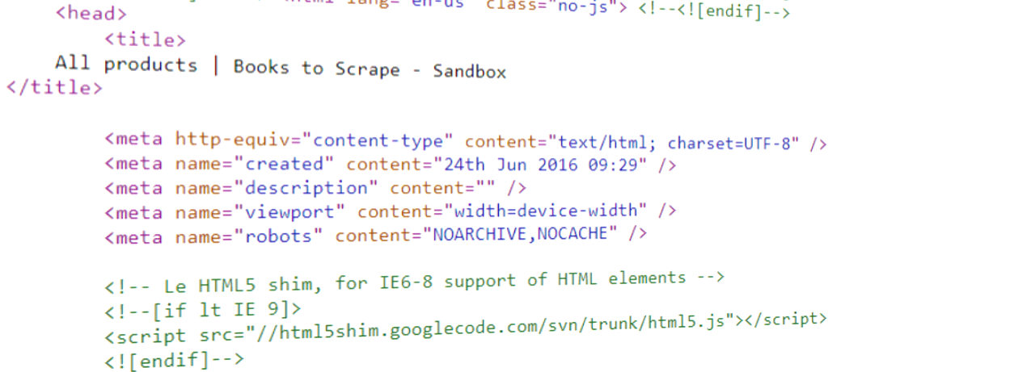
An Introduction to Web Scraping
Coffee and Coding

Slide 2
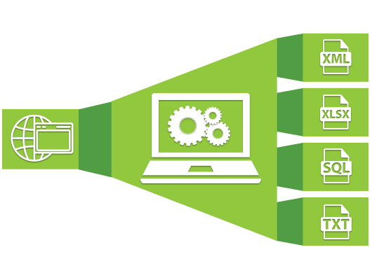
To start…
Who knows what web scraping is?
Who has used it before?
What is the main thing you want to learn today?
This is an introduction to show what is possible and where to look for more guidance

Slide 3
In this C&C talk
What is web scraping
When is web scraping useful
Legal implications
How web scraping works
Useful R packages
Example 1 – Simple HTML table
Example 2 – The Book Store

Slide 4
What is web scraping?
“Web scraping, web harvesting, or web data extraction is data scraping
used for extracting data from websites.”
Boeing & Waddell 2016
Two types of online data
Structured data files (“easy” web scraping)
Plain-text data (e.g. csv) stored at secure or non-secure URLs
Data stored in a database with a well structured API (Application Programming Interface)
URL is all you need, multiple datasets are saved with defined URLs → looped downloads possible
Not as well structure information (“difficult” web scraping)
Html tables
Text on websites
Information requiring navigation of web forms
Information needs to be identified: Either by html “node" (best way) or by string pattern (if nodes are not an option)

Slide 5
When web scraping can be useful
A lot of useful data is stored on webpages in unstructured format. We all have used the simplest form of web scraping – copy-pasting – but for more complex tasks, automation saves time and is more efficient.
Certain data can be collected from the web and processed without spending too much resources – both time-wise and financially.
Principles of reproducibility apply:
Fully document your web scraping
Find (inevitable) mistakes
Easy to re-run or update if webpage content changes
Can apply scraping methods to other webpages

Slide 6
Legal implications
Web scraping can put strain on the servers of a website and can cause issues for the provider
Check the terms of service of a website before scraping
Think about the use of the data (exploratory vs business)
Some webpages will block access after a certain amount of website requests within a short amount of time (e.g. Google)

Slide 7
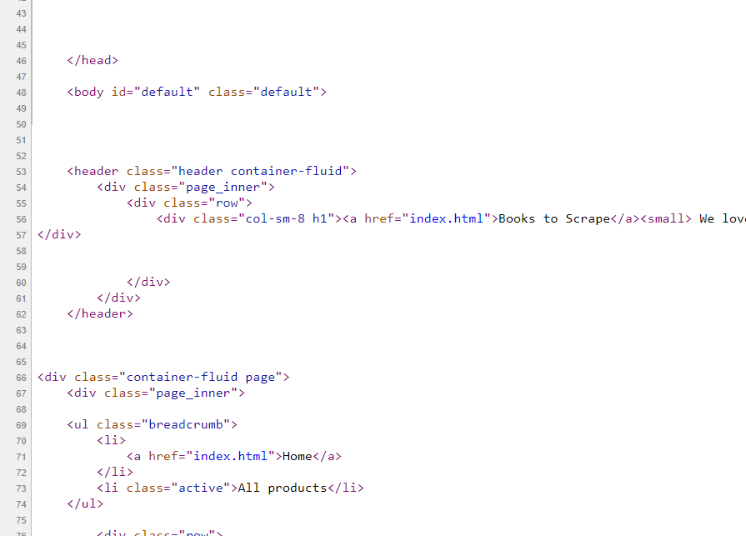
How it works
Tags (pink)
Tag attributes (blue)
Web pages are coded in order to correctly display in browser
Most common coding language is the “Hypertext Markup Language” (HTML)
Text is “marked up” in html via the use of “tags” (e.g. formatted in <b>bold</b>)
Querying the html code for those tags lets us find and extract the needed information
Easiest way to explorer the html code of a webpage is the “Inspect” element in browsers (“right click” → “View page source”, or “Ctrl+U” in Chrome)
Marked up text (black)

Slide 8

Web scraping in R with rvest
rvest is a package for easy scraping (or “harvesting”) of data from webpages
Main rvest functions:
read_html(): converts a website into an xml object
html_node(): extracts relevant “nodes” from an xml object, with an argument either for
Tags (e.g. “body”); or
Classes (e.g. “.header container-fluid”, the “.” signifies that the argument is a class)
html_text(): extracts the data from the selected nodes
html_attrs(): extracts the data from attributes (in case one is after the attribute and not the text)

Slide 9
Key steps
Look at the HTML for the webpage you want to scrape (e.g. use Inspect Element in Chrome).
Request a URL with rvest::read_html().
Extract the specific content nodes from the request with rvest::html_nodes().
Convert the nodes to your desired R object type.
Clean the data.

Slide 10
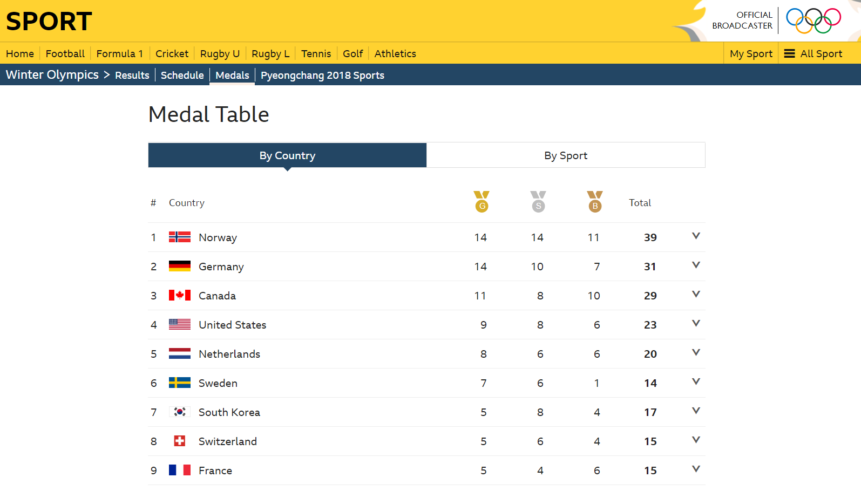
Example 1 – HTML table
https://www.bbc.co.uk/sport/winter-olympics/medals/countries
library(tidyverse)
library(rvest)
URL <- paste0(“https://www.bbc.co.uk/sport/winter-olympics”,
“/medals/countries”)
medals_table <- URL %>% read_html() %>%
html_nodes(‘medals-table__table') %>%
html_table() %>%
as.data.frame

Slide 11
Example 2 – The Book Store
Have a look at http://books.toscrape.com/ and investigate the page and the page source
Open up the “R script - web scraping example 2” file on github if you want to run the code alongside

Slide 12
Relevant coding areas
Tidy data
Web scraped data might not come in a tidy format and might have to be converted
See dplyr package
Character encoding
Some html text might be in latin1 and needs recoding to UTF-8 with the iconv function
Stringr and regular expressions
For identifying and manipulating strings
See stringr package
Functions
For structuring more complex web scraping and to keep the code modular and easy to test and improve

Slide 13
References and further sources
Rstudio blogpost on rvest package (2014)
Good introduction into main functionality (how to work with html code in R)
Link: https://blog.rstudio.com/2014/11/24/rvest-easy-web-scraping-with-r/
Free data camp tutorial on web scraping (2018)
Useful overview over the process of identifying the location of information and how to loop the harvest process over a collection of pages
Detailed usage of functions → Crucial when building one's own custom built process
Link: https://www.datacamp.com/community/tutorials/r-web-scraping-rvest
Regular expressions training materials
https://stackoverflow.com/questions/4736/learning-regular-expressions/2759417#2759417
https://regexone.com/
Digital Methods Initiative at Amsterdam University (2019)
Internet studies research group
Useful collection of web scraping tools (many work as standalone tools)
Link: https://wiki.digitalmethods.net/Dmi/ToolDatabase

Slide 14
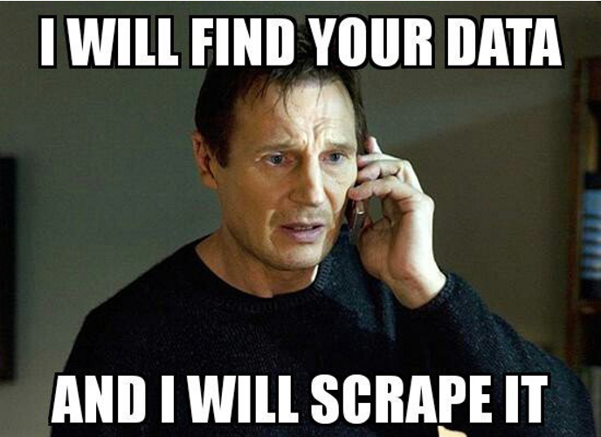
Time for Memes

Slide 15
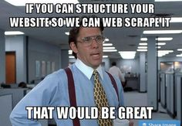
Time for Memes

Slide 16
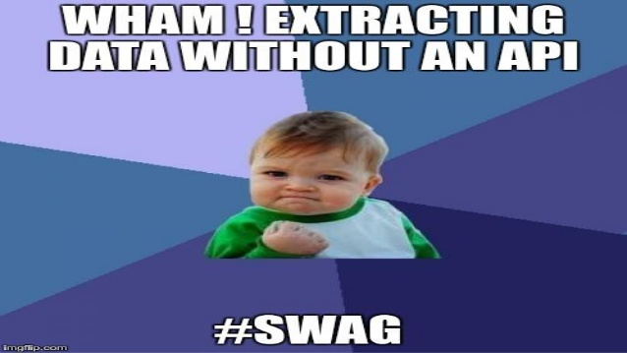
Time for Memes

Slide 17
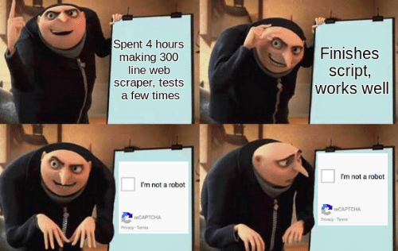
Time for Memes

Slide 18
Thank you

